Slide 1
AGE AND GENDER DETECTION
PRESENTED BY :
Name : Rampriyaa R
Reg.No : 613521104034
Department : CSE 3rd year

Slide 2
TABLE OF CONTENTS
Agenda
Objectives
Dataset Description
Methodology
Data Pre-processing
Building a CNN model
Model Compilation
Testing and Deployment
Real world use-cases

Slide 3
AGENDA
The age and gender classification system is used to categorize human images into various groups determined by facial features . Estimating human age group and gender automatically via facial image analysis has lots of potential real-world applications , such as human computer interaction and multimedia communication .
The successful applications of CNN on many computer-vision tasks have revealed that CNN is a powerful tool in image learning . If training data are given , CNN is able to learn a compact and discriminative image feature representation .
This project aims to detect age and gender which works on the mechanism of deep learning using convolutional neural network.

Slide 4
OBJECTIVES
To pre-train the age and gender detection model using the public Datasets such as UTKFace .
To use facial images to detect the age and gender provided to the model .
To use model and expose it in as API using Flask or other .

Slide 5
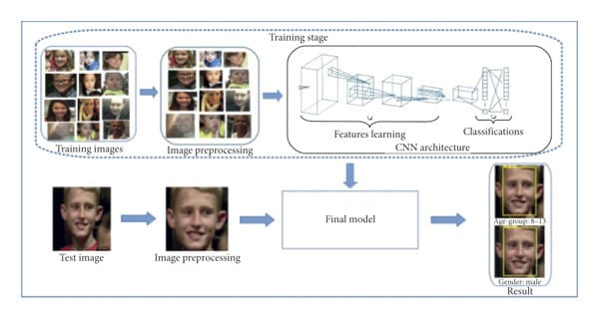
STAGES OF TRAINING:

Slide 6
DATASET DESCRIPTION:
UTKFace dataset is a large-scale face dataset with long age span (range from 0 to 116 years old).
It has a total of 23708 images. The images cover large variations in facial expression, illumination, pose, resolution and occlusion.
We chose this dataset because of its relatively more uniform distributions, the diversity it has in image characteristics such as brightness, occlusion and position and also it involves images of the public data.
Each image is labeled with a 3-element tuple, with age (in years), gender (Male-0, Female-1) and races (White-0, Black-1, Asian-2, Indian-3 and Others-4) respectively.
We used the same set of images for training, testing and validation, to have standardized results. This was done by dividing the data sets into train, test in 80: 20 ratios .

Slide 7
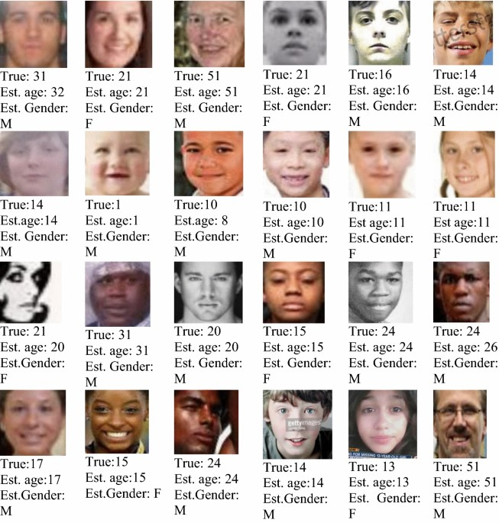
DATASET : https://www.kaggle.com/datasets/jangedoo/utkface-new

Slide 8
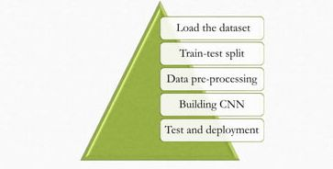
METHODOLOGY

Slide 9
DATA PRE-PROCESSING :
Grayscale conversion
Resizing
Storing in numpy array
Normalization

Slide 10
Graycycle conversion
The conversion of a color image into grayscale image is converting the RGB values(24 bit) into grayscale value(8 bit) .Grayscale simplifies the algorithm and reduces computational requirements .
Resizing
Deep learning models train faster on small images. Neural networks receive inputs of the same size, all images need to be resized to a fixed size before inputting them in CNN .Here we are resizing it into 128 X 128 .
Storing in numpy array
Neural networks can handle only Numpy array . Numpy arrays takes significantly less amount of memory .So we are appending all the images into a Numpy array .
Normalization
Data normalization is used to standardize data which ensures that each input parameter (pixel , in this case) has similar data distribution .This makes convergence faster while training the data .

Slide 11
CNN MODEL :
The tasks tackled using the deep CNN approach include gender classification and age estimation. The basic structure includes a series of convolutional blocks, followed by a set of FC (fully connected) layers for classification and regression
Every architecture comprises convolutional blocks that are a stack of convolutional layers (filter size is 3x3) followed by non-linear activation "ReLU", max pooling (2x2) and batch normalization to mitigate the problem of covariate shift.
Following the convolutional blocks, the output is flattened before feeding that into FC layers. These FC layers have activation function of ReLU, dropout (value between 0.2 & 0.4) and batch normalization.
During training, the CNN learns the optimal values for filter matrices that enable it to extract meaningful features from input feature

Slide 12
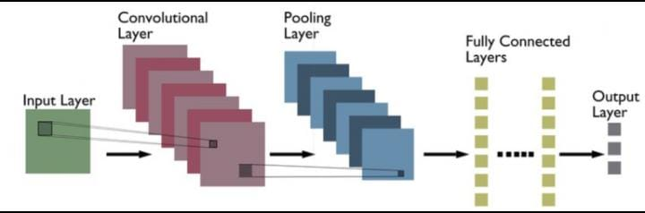
BASIC CNN STRUCTURE :

Slide 13
MODEL COMPILATION :
Loss function
Binary cross entropy for gender classification
Mean absolute error for age detection
Optimizer : Adam
Metric : Accuracy

Slide 14
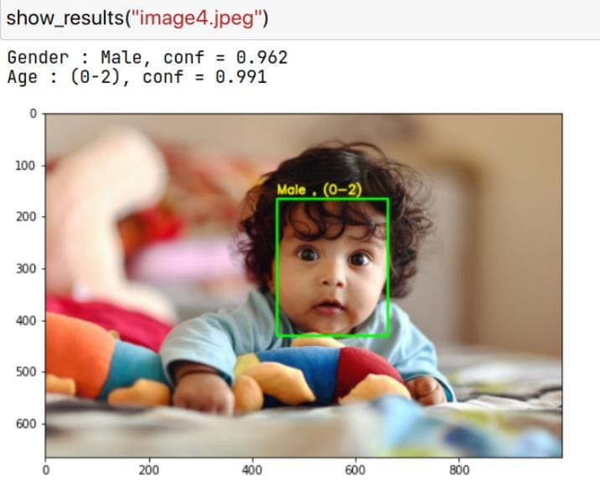
TESTING AND DEPLOYMENT :
This model is finally tested with a test data and the results are obtained and deployed using VScode and streamlit .

Slide 15
REAL WORLD USE CASES :
Quividi is an Al software application which is used to detect age and gender of users who passes by based on online face analyses and automatically starts playing advertisements based on the targeted audience.
Another example could be AgeBot which is an Android App that determines your age from your photos using facial recognition. It can guess your age and gender along with that can also find multiple faces in a picture and estimate the age for each face.

Slide 16
Thank You

